Slide 1
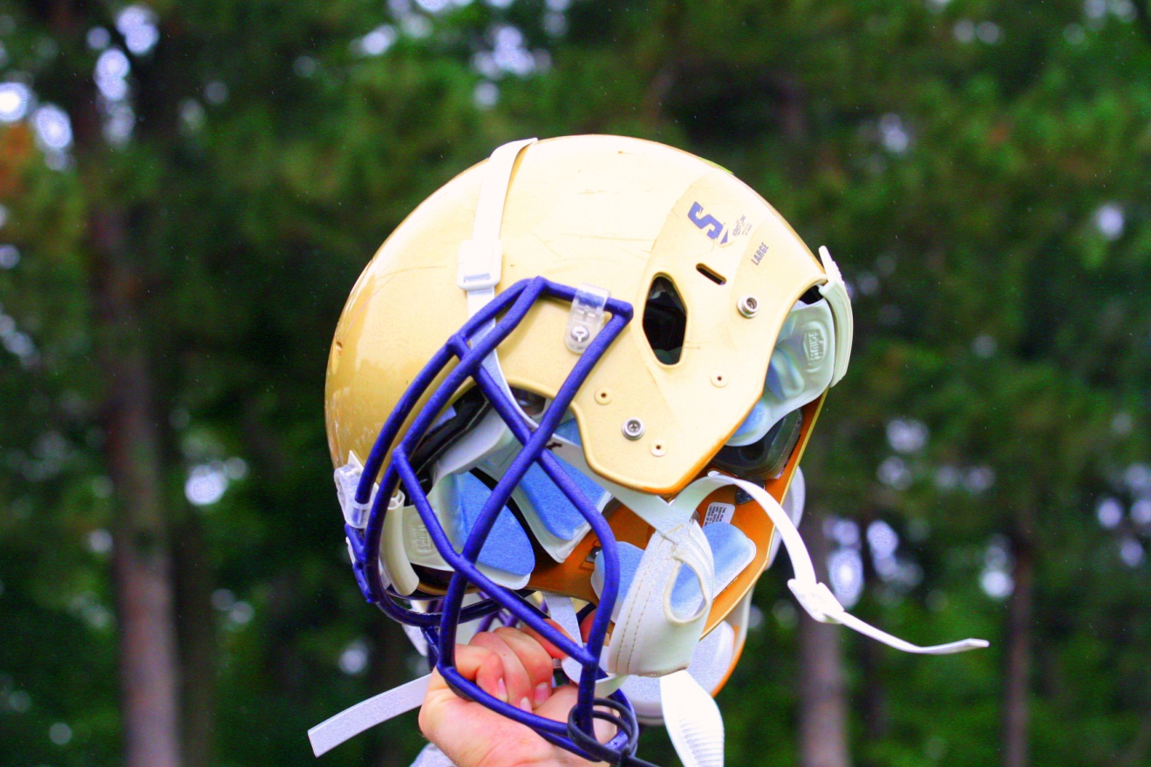
Eagle football
One heart. One mission.

Slide 2
The power of the put-up Game
Momentum is a powerful force that can affect each of our own and our teammate’s performance. Momentum is influenced by various factors and one of the biggest factors is utilizing…

Slide 3
There is synergy in the put-up game!
We ALL start to respond positively to challenges and adversity when we start pushing the PUT-UP buttons in ourselves and others…

Slide 4
praise – Encourage – thankful
…with the genuine belief that we are going to bring out the best in each other. It is a great feeling to close our own and our teammate’s potential performance gap*; and we do that by hitting the right buttons.
* The difference between your current performance and the actual best performance you could ever give…

Slide 5
What’s the pay value of the put-up game?
A higher level of performance
Better appreciation of the experience
  The Success Road
    The journey is the destination.
  Enhances and challenges our love for each other
  Allows for synergy to take place
    The Double Win
      If I help you and you help me, we both win!

Slide 6
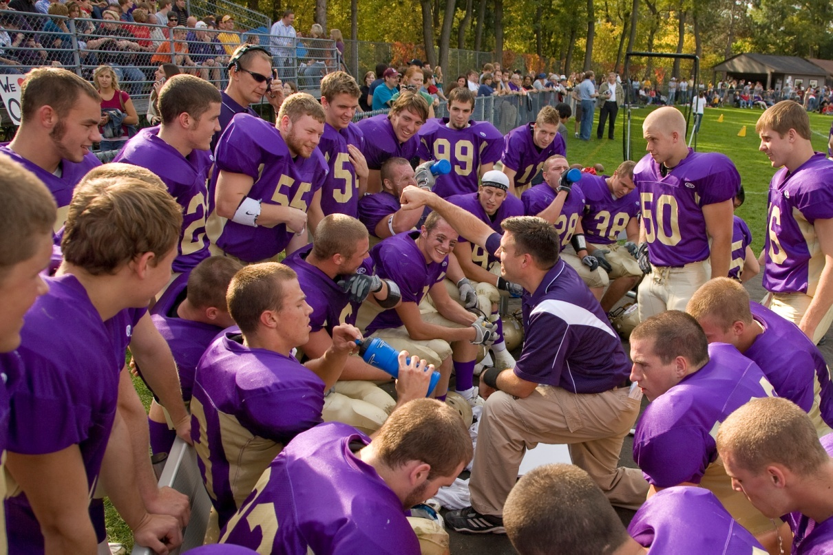
By lighting each others candles
WE ALL SHINE BRIGHTER, BY GOD’S HOLY SPIRIT AND THROUGH HIS WORD!

Slide 7
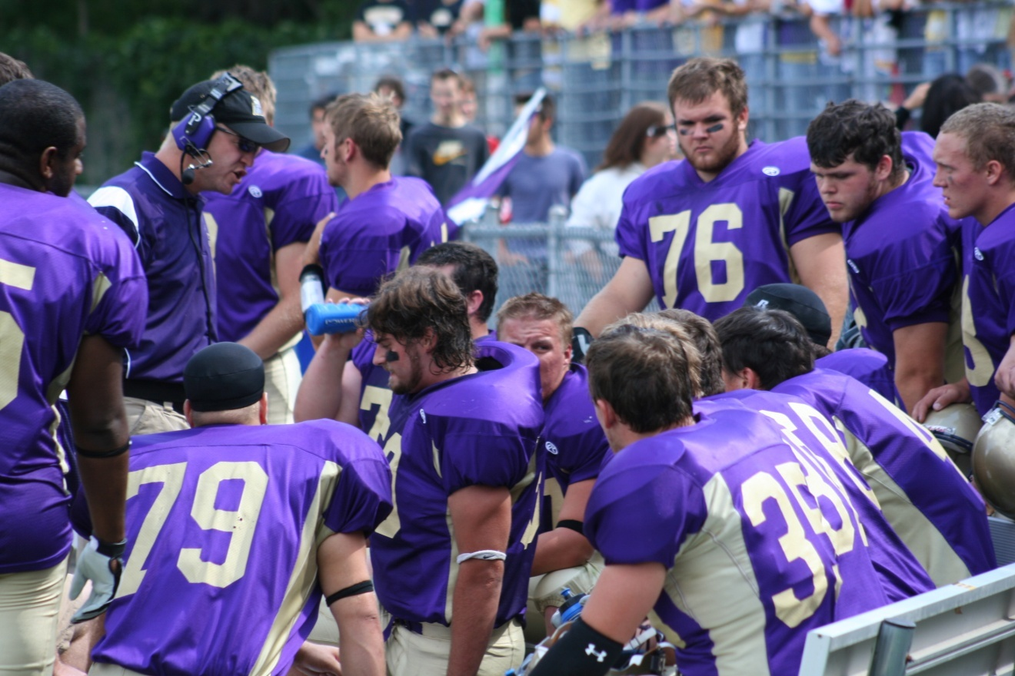
THE POWER OF THE PUT-UP
MAKE IT CONTAGIOUS!

Slide 8
Eagle football
One heart. One mission.
The heart of the battle is the battle for the heart.

